Slide 1
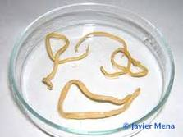
Phylum nematodes
Important Nematodes

Slide 2
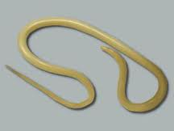
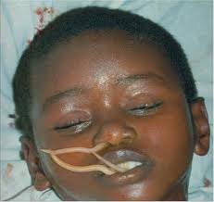
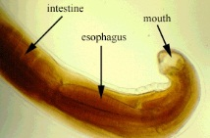
Ascaris lumbricoides
Giant intestinal roundworms of humans
Askaris- intestinal worm
Live in the small intestines of human
Produce large number of eggs & exit with feces

Slide 3
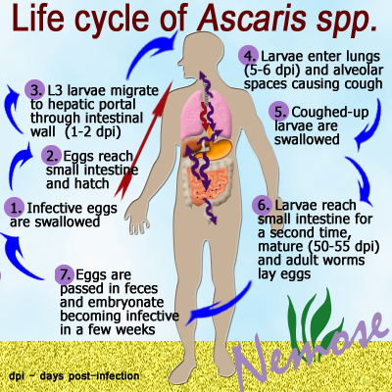
Ascaris lumbricoides

Slide 4
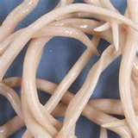
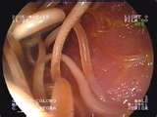
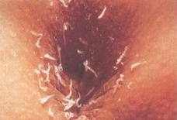
Enterobius vermicularis
Enteron – intestines; bios- life
The Human Pinworm
Found in large intestines and rectum

Slide 5
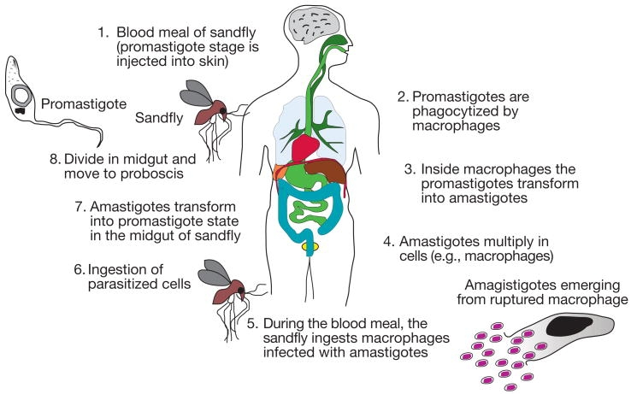
Enterobius vermicularis
Life Cycle

Slide 6
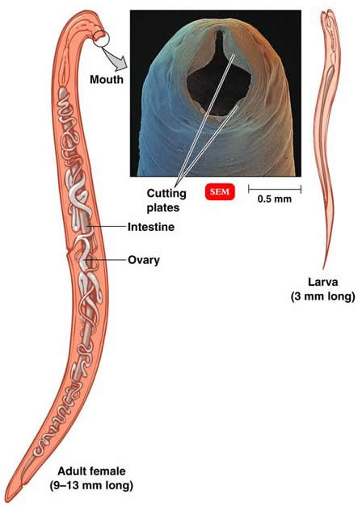
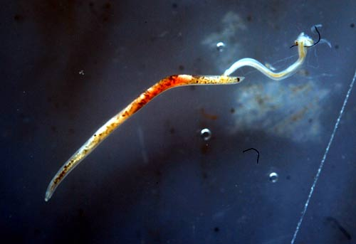
Necator americanus
Necator-killer
The new world hookworm
Found in intestinal walls
Become infective filariform during 3rd stage

Slide 7
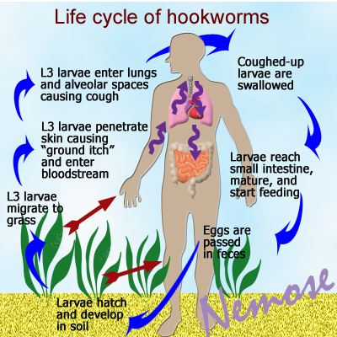
Necator americanus
Life Cycle

Slide 8
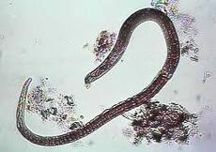
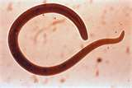
Trichinella spirales
Trichinos – hair
The Porkworm
Results to a disease called Trichinosis

Slide 9
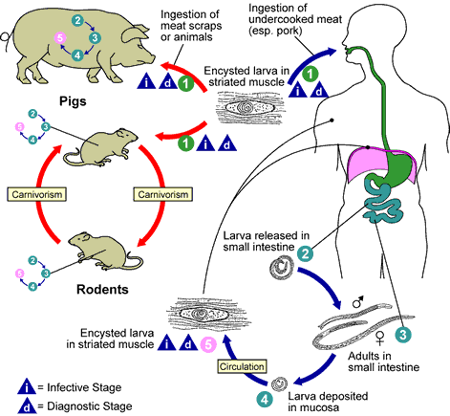
Trichinella spirales
Life Cycle

Slide 10
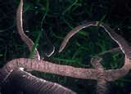
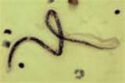
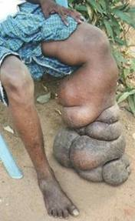
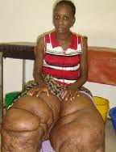
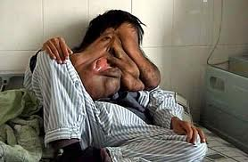
Wuchereria spp...
2 types
Wuchereria bancrofti & Wuchereria malayi
The filarial worms; filium – thread
Live in the lymphatic system , where the adult worms copulate to form a larvae called microfilariae
Block the blood vessel

Slide 11
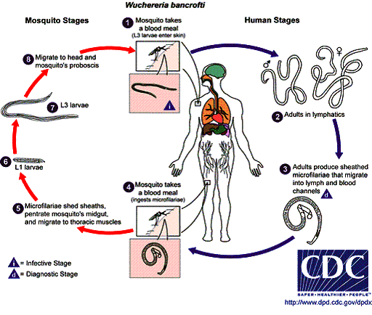
Wuchereria spp...
Life Cycle

Slide 12
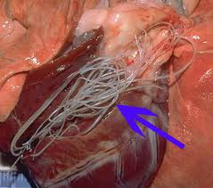
Wuchereria spp...
A dog parasite, a filarial worm is called Dirofilaria immitis
The adult worm live in the heart and large arteries of the lungs
The infection is called heartworm disease

Slide 13
Wuchereria spp...

